Slide 1

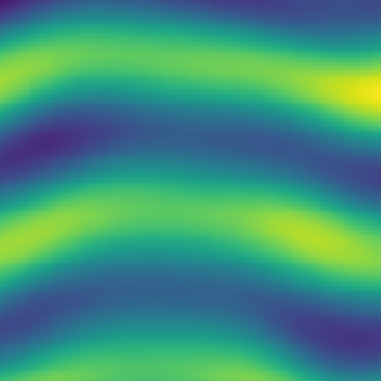



Input
Prediction
5x5 Convolutions
$$t−1$$
$$t−20$$
$$t$$

